Slide 1
intro to web development
Shannon Turner
Twitter: @svt827
GitHub: @shannonturner

Slide 2
Copy a project from Github
Make changes to that project
Test those changes
Upload your new version to Github
Learn about virtual environments
Learn about web development in Django

Slide 3
overview: copying a project
Forking means to make an exact copy of another person's Github repository and save it to your account
Cloning means to download an exact copy of a Github repository and save it to your computer

Slide 4
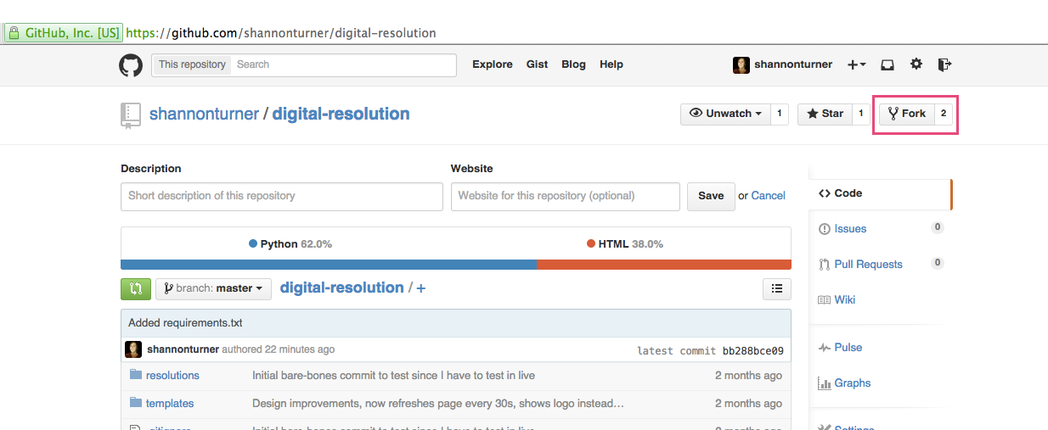
How to fork a repo
Fork this: https://github.com/shannonturner/digital-resolution

Slide 5
why fork?
You can't make changes to my repos without my permission.
But since my repos are public, you can fork (copy) mine and make changes to your copy all you want!
If you make really cool changes, I could merge your changes into my original!

Slide 6
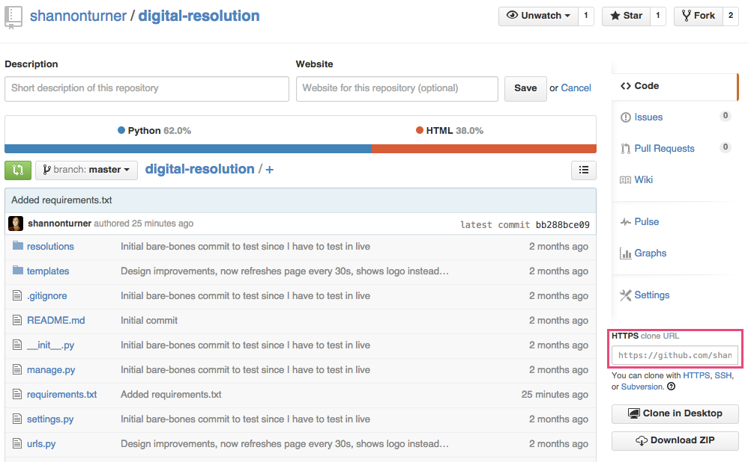
How to CLone a repo
In your newly-created fork, copy the Clone URL to the clipboard.

Slide 7
How to CLone a repo
In your newly-created fork, copy the Clone URL to the clipboard.
In your terminal, navigate to the folder you'd like to store your local copy.
git clone https://github.com/username/repository-you-want-to-clone.git

Slide 8
How to CLone a repo
Did that fail? You'll need to install git onto your computer.
Did that work? Congratulations! You just downloaded an exact copy of a repo onto your computer! (Now help a neighbor)
Cloning creates a folder (the name of the folder is the name of the repo) inside your current folder, with the entire repo's contents.

Slide 9
why clone?
Cloning creates a copy of the project on your computer.
You can then run your local copy, make changes, and test those changes, all without affecting the original project.
This is great for testing and for creating new features and designs!

Slide 10
Virtual environments
Before we can run the project, we'll need to set up a virtual environment.
Virtual environments allow you to separate your different installations of python and python libraries from one another.
This helps you avoid version conflicts and run projects after you've cloned them.

Slide 11
Get virtualenv
In the terminal, run pip install virtualenv
If you're on a Mac, you'll probably need to run sudo pip install virtualenv
This will install virtualenv, which will allow you to create new virtual environments.

Slide 12
virtualenv
We want to create a virtual environment for our new project.
In my example, I was in the github folder when I cloned my digital-resolution repo.
I'll want to navigate back to the github folder now. If you haven't changed folders since cloning, good!

Slide 13
Creating a virtualenv
From the github folder, I'm going to run the following command in the terminal:
virtualenv digital-resolution
This creates a new virtualenv in the digital-resolution folder

Slide 14
what does it do?
When you run virtualenv, it creates a new, separate python installation in that folder.
This installation creates new folders (bin, include, lib) inside digital-resolution
You need to activate your virtualenv before you can use it for this project.

Slide 15
activating your virtualenv
To activate your virtualenv, change directory into the digital-resolution folder.
From there, in the terminal, run:
source bin/activate
You'll notice your command prompt has changed a bit! This is a cue that your virtualenv is active.

Slide 16
installing requirements
All of the necessary libraries needed to run digital-resolutions have been saved in a file called requirements.txt
Make sure your virtualenv is active, then in the terminal, run:
pip install -r requirements.txt
Notes:
On Macs/Linux, when using virtualenv, you won't need to sudo pip install.

Slide 17
installing requirements
pip install -r requirements.txt
This installs all of the python libraries this project needs into your virtual environment.
requirements.txt is a special file that I included in the digital-resolutions repo to make it easier to install all the libraries you need.
Notes:
On Macs/Linux, when using virtualenv, you won't need to sudo pip install.

Slide 18
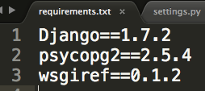
installing requirements
What's in requirements.txt?
It's a list of names of python libraries and which versions to install.
Python will auto generate this file when you run pip freeze > requirements.txt (don't do this now, but remember for later!)

Slide 19
making a change
My version of digital-resolutions uses a PostgreSQL database.
Setting that up on our computers would take about 45 minutes by itself, so let's use a simpler solution.
There's a type of database called SQLite that creates a small database file.

Slide 20
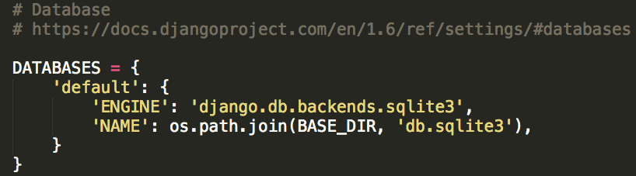
making a change
To use SQLite instead of PostgreSQL, we need to edit our settings.py file. Find the DATABASES variable (line 60) and change it to:

Slide 21
Git notices our changes
Git keeps track of any changes you've made to your files.
In the terminal, git status will tell you which files you have modified since the time you cloned or last committed.

Slide 22
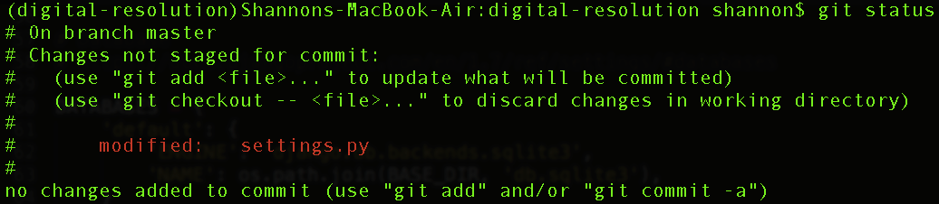
git status
git status also tells us
the branch we're on
hints on how to add files or to discard changes we've made.

Slide 23
git diff
To see the changes we've made in detail, you'll run git diff.
git diff will show you all of the changes you've made to all of your files in this repo since your last commit.
git diff settings.py will show you the changes you've made just to the settings.py file since your last commit.

Slide 24
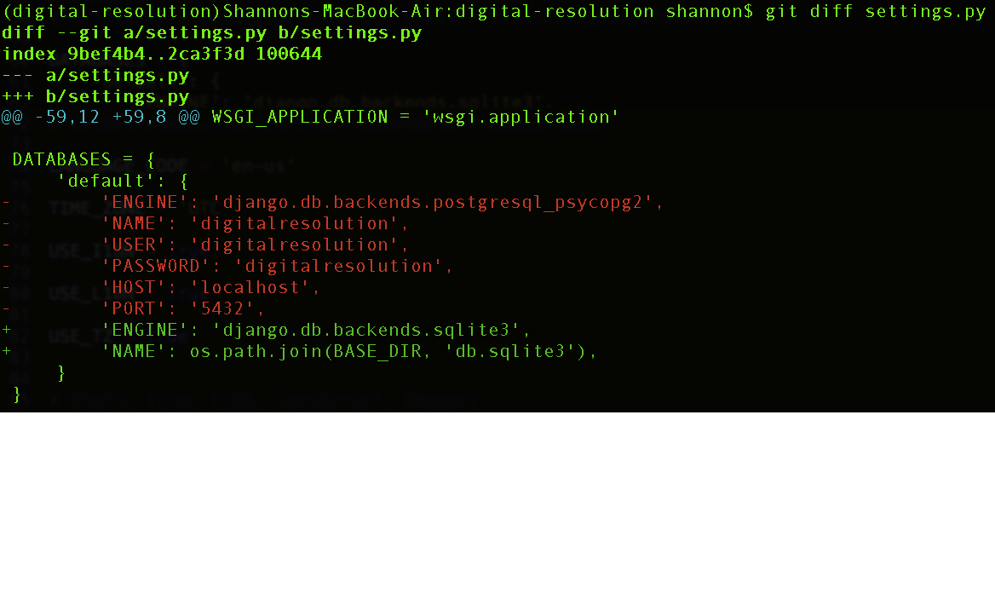
git diff
Notes:
Red are deletions, dark green are additions. Also note the plus / minus signs on the far left.

Slide 25
django setup
Make sure your virtualenv is active and you're in the digital-resolutions folder.
In the terminal, run ./manage.py syncdb
This will create the database tables Django needs to run.
This will also prompt you to create a superuser account for your Django admin. This is important, so write down your username and password!
Notes:
Before doing this step, make sure nobody has any existing SQLite database in the folder from a previous installation or it'll be overwritten.

Slide 26
django setup
Make sure your virtualenv is active and you're in the digital-resolutions folder.
In the terminal, run ./manage.py runserver
This will tell Django to run a web server locally on your computer. Only you can access it.

Slide 27
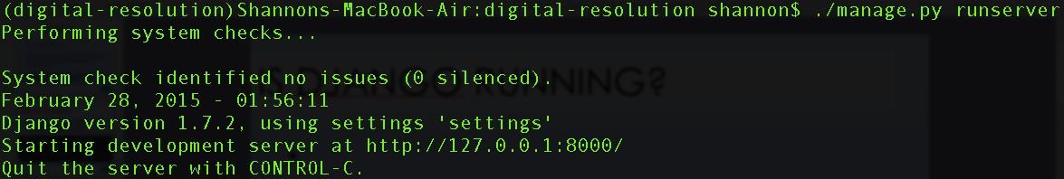
is django running?
If Django failed, it'll give us an error. If it succeeded, you should see a message something like:
Open a web browser and go to http://127.0.0.1:8000/admin to see if it worked!

Slide 28
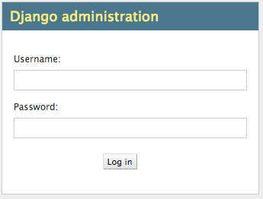
is django running?
If it looks like this, we're in good shape!
Log in with your Django admin superuser credentials you just created.

Slide 29
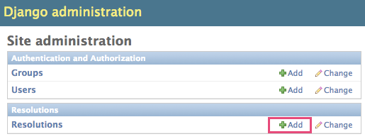
In the django admin interface
In the admin panel, you should see Resolutions and an add button.

Slide 30
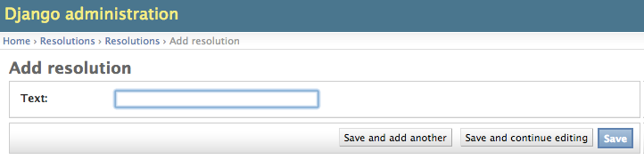
In the django admin interface
Enter some text for your resolution and click Save.
Example: I want to learn web development!

Slide 31
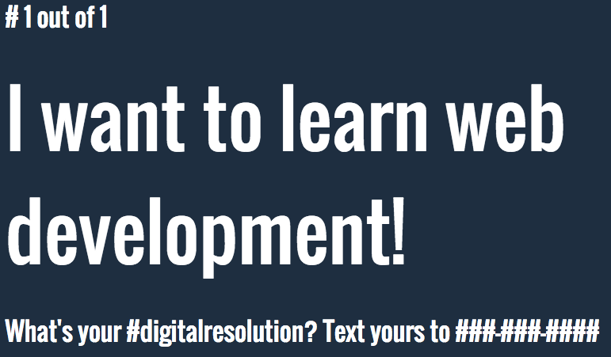
moment of truth
Did it work? Go to http://127.0.0.1:8000

Slide 32
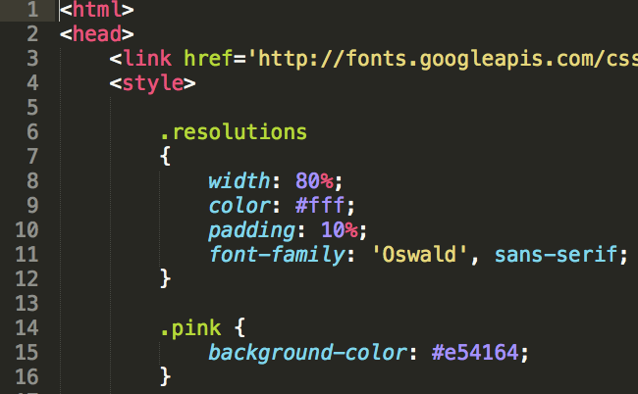
now, let's make some real changes
Open up digital-resolution/templates/resolutions.html in Sublime Text.

Slide 33
now, let's make some real changes
resolutions.html: Django uses this to display our resolutions on a webpage.

Slide 34
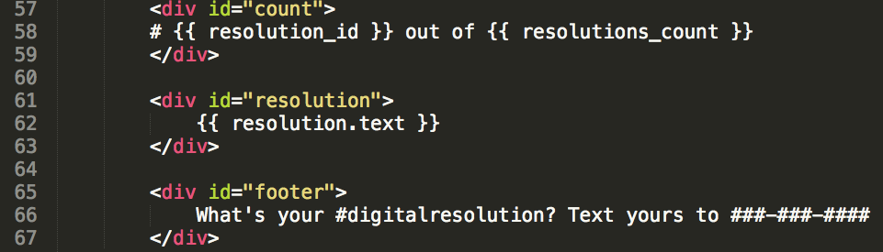
html, css, python, etc.
Django's templates use a mix of HTML, CSS, logic, and variables all wrapped up together.
See line 62: {{ resolution.text }}

Slide 35
Make some changes!
Ideas of what you could change:
The "Whats your #digitalresolution" text
The CSS colors available
The page refresh time
Whether or not/how often to show logos
Show different logos
The layout of the page
Something else, get creative!
Notes:
Take some time with this! Save your changes and refresh the page.

Slide 36
once you've made changes
You've each made different changes to your own local copies.
Now we're going to save those changes to our individual forks of the original project.
Remember, changes you make to your fork (copy) don't affect anyone else's!

Slide 37
saving changes to your repo
Step 1: git status to see all of the files you've edited. Should be settings.py and templates/resolutions.html
Step 2: git diff to see line by line all of your deletions and insertions (changes) for each file. Make sure those look good! If not, edit the files, save, and git diff again.

Slide 38
saving changes to your repo
Step 3: Use git add to add the files you changed.
git add settings.py
git add templates/resolutions.html
There are other ways to add all changed files, but I personally like this method because I can choose which files I add.

Slide 39
saving changes to your repo
Step 4: Commit your changes using git commit -m "Lowered page refresh time to 15 seconds"
Substitute your own commit message inside the quotes! (Maybe you didn't adjust the page refresh time)
Be descriptive! What changes to your files did you make? Say it here!
In your commit message, you can't end with an exclamation point! If you do, you'll get an error.

Slide 40
saving changes to your repo
Step 5: Push your changes to Github using git push
Most likely, you'll be prompted for your Github username and password.
Visit your fork on Github. Are your changes there? If so, celebrate!

